Slide 1
SensorLM
Sravya Ganti, Harshit Nanda and Maatla Sefawe
Notes:
Sravya

Slide 2
Agenda
Summary
Impact
Market
Significant Issues
Ongoing work
Appendix
Notes:
Sravya

Slide 3
Summary
Notes:
Sravya

Slide 4
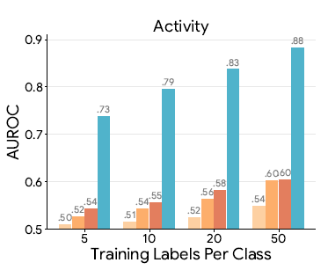
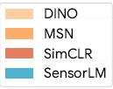
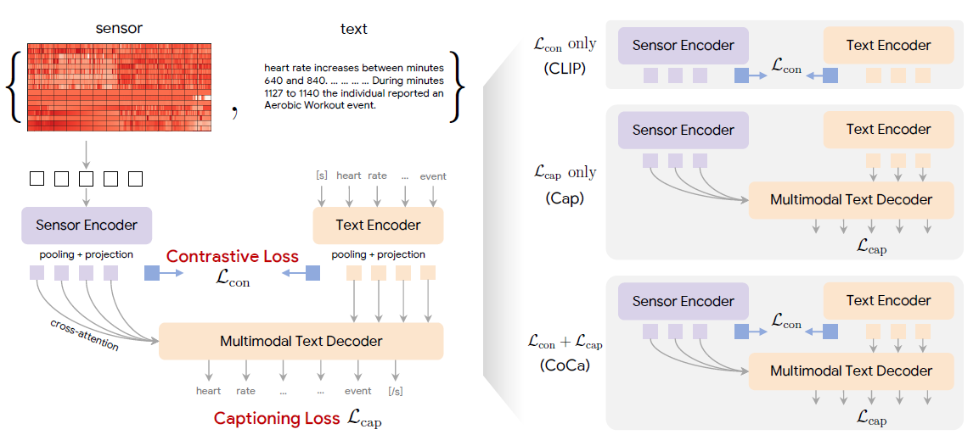
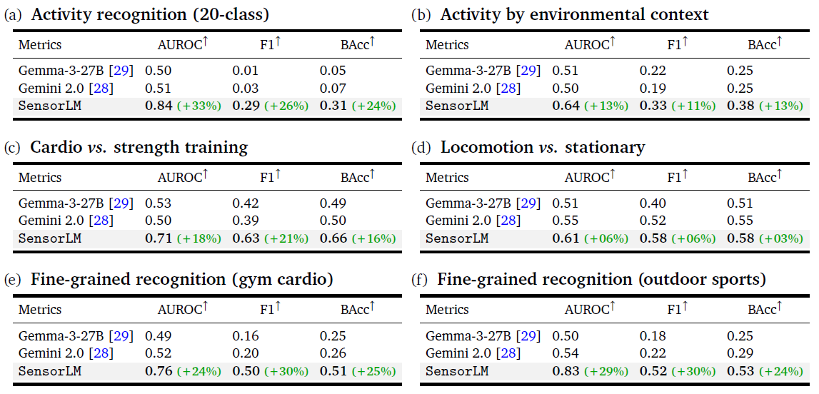
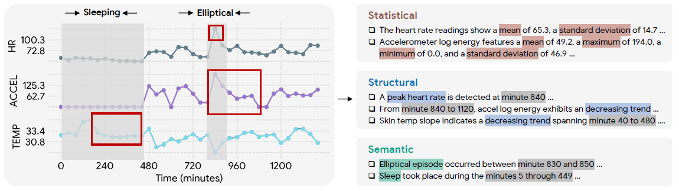
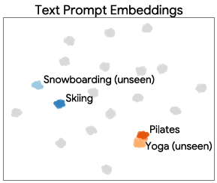
SensorLM enables sensor data understanding with natural language
Largest compiled dataset of wearable sensor data
59 million hours
>103,000 people
Outperforms SOTA
Unique pretraining architecture
Caption Generation Pipeline
Notes:
SRAVYA
Key contributions:
Largest compiled dataset of sensor data – 59 million hours from > 103,000 subjects
Hierarchal and automated caption generation pipeline
Statistical, structural, semantic captions generated using randomized templates
Unique pretraining architecture
Common multimodal architectures are combined into one general architecture
Leverage both contrastive and generative objectives
Outperforms SOTA on zero-shot activity recognition, few-shot learning, cross modal retrieval
Zero-shot activity recognition it outperforms LLMs such as Google Gemini and Gemma
In few-shot learning it outperforms state of the art self-supervised learning methods developed by Facebook and Google researchers
When trained on a dataset with very few labels it can still achieve a high accuracy of activity recognition
Zero shot generalization
It can map classes it hasn’t’ seen before closely to other similar classes
Interesting takeaways:
Scalability
Zero-shot generalization to unseen tasks
Architecture scaling laws from other domains seem to hold in SensorLM
Combination of semantic and structural captions in dataset construction improves zero-shot AR
AUROC stands for Area Under the Receiver Operating Characteristic Curve
Photoplethysmography (PPG), Accelerometer (ACC), Skin Conductance (electrodermal activity, EDA), Skin Temperature (TEMP), and Altitude (ALT).

Slide 5
Impact
Notes:
Harshit

Slide 6





A Paradigm Shift in Sensor-Language Foundation
SensorLM study represents a foundational leap in integrating complex wearable sensor data with language understanding
LLM Architecture
Dedicated sensor encoder
Multimodal text decoder
Hybrid contrastive + captioning training
Dataset Impact
Largest sensor-language dataset to date (59.7M hours)
Novel hierarchical caption generation pipeline
Inputs from five sensor types
Empirical Performance
Exceptional zero-shot classification
High label efficiency
Strong zero-shot cross-modal retrieval
Notes:
SensorLM is a very recent 2025 paper, and it represents a major step forward in sensor-language modeling. It introduces a dedicated encoder for raw sensor signals, a multimodal text decoder that can reason over them, and a hybrid training objective that tightly aligns sensors with natural language. Because of this, the model achieves strong zero-shot classification, high label efficiency, and strong cross-modal retrieval. And all of this is enabled by the largest sensor-language dataset ever created — nearly 60 million hours — built using a new hierarchical captioning pipeline across five sensor types.

Slide 7
Market
Notes:
Harshit

Slide 8
Traditional Models
Human Activity Recognition
LLMs: Zero-shot/Few-shot Learning
SLMs: Efficiency and Low Latency
Time series foundational models
Healthcare and Rehab
Smart Home and Assisted Living
Behavioral and Daily Life Monitoring
Notes:
Traditional models aren’t great with sensor data. Big language models can’t read raw sensor signals, smaller models don’t generalize well, and time-series models don’t really understand meaning. But human activity recognition is important for things like healthcare, rehab, smart homes, and daily-life monitoring. So we need a model that understands sensors and language at the same time. That’s what SensorLM does — it connects sensor patterns with natural-language descriptions so we can reason about sensor data in a much smarter way.

Slide 9



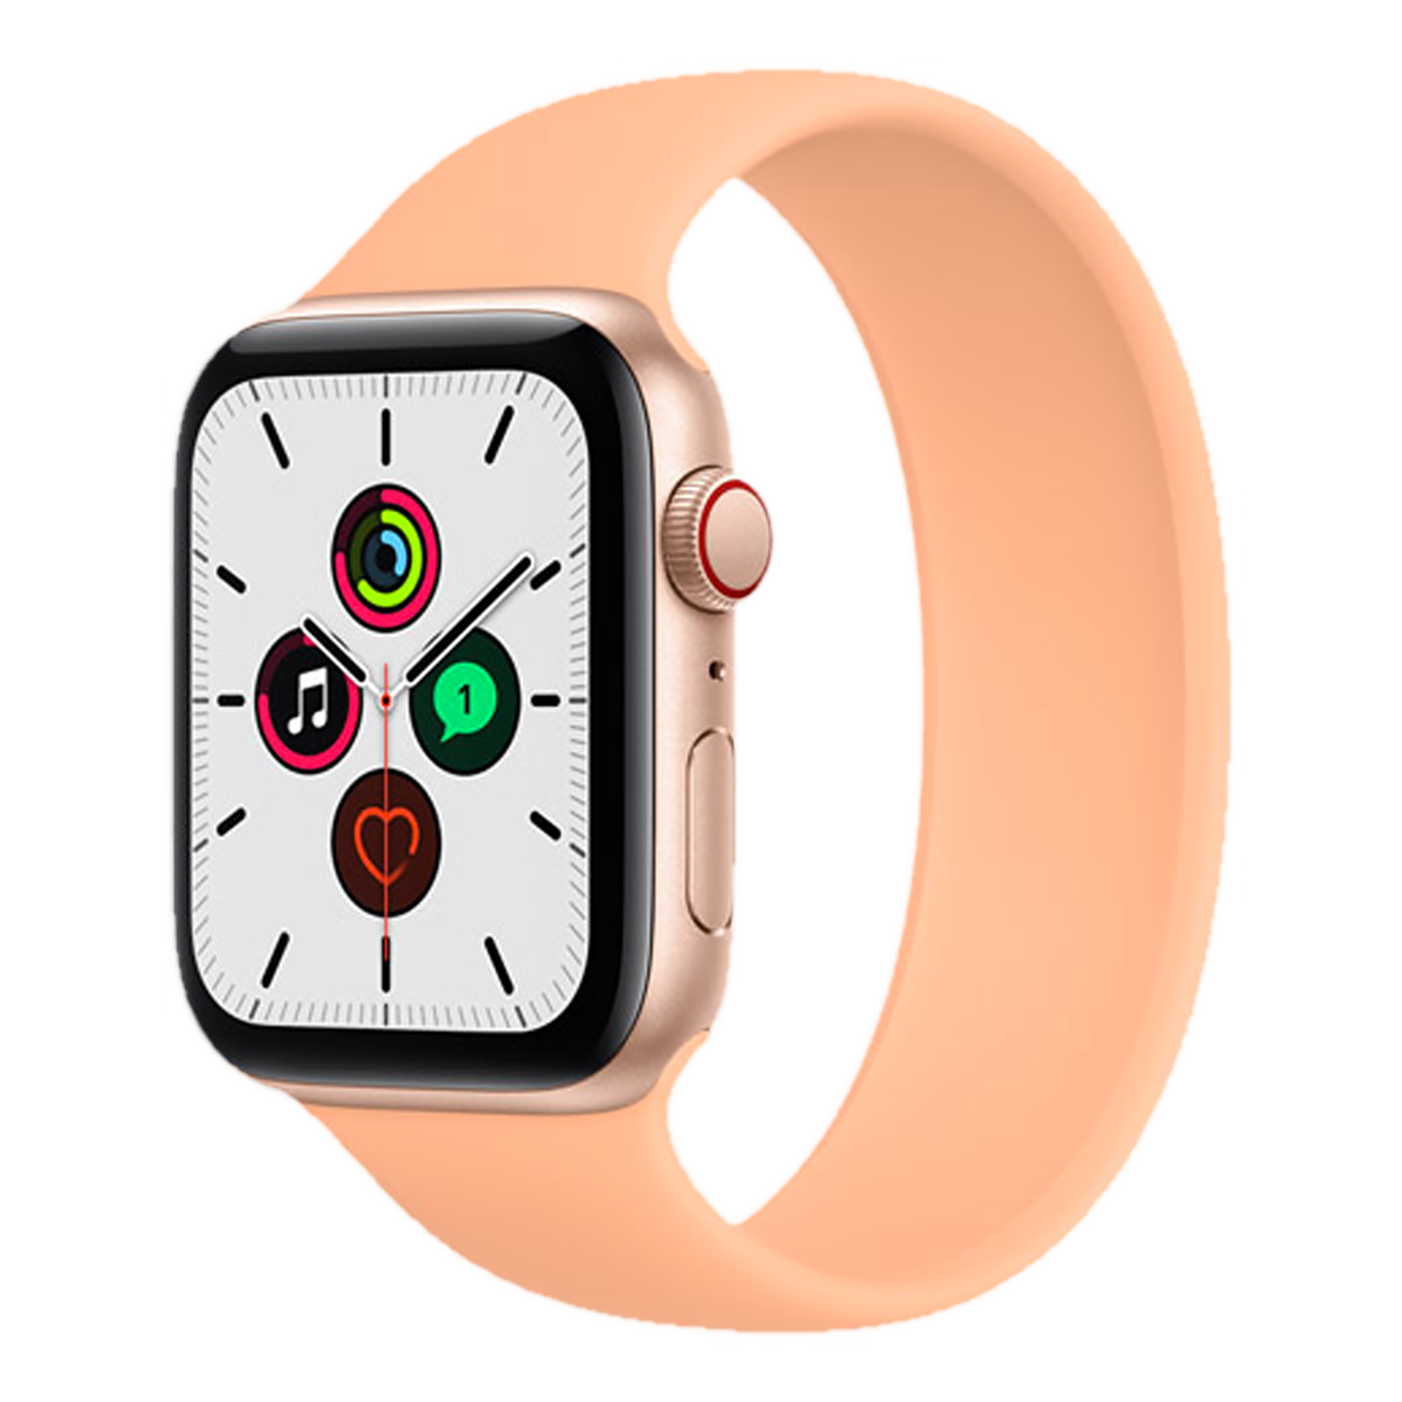
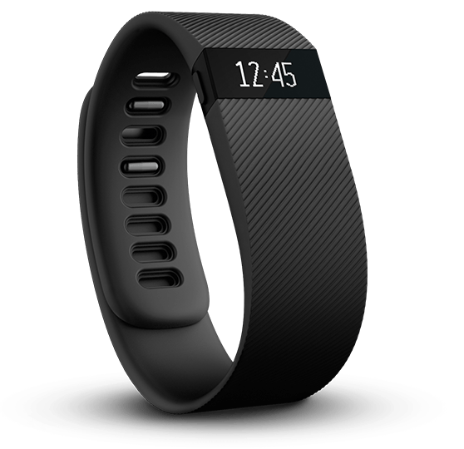
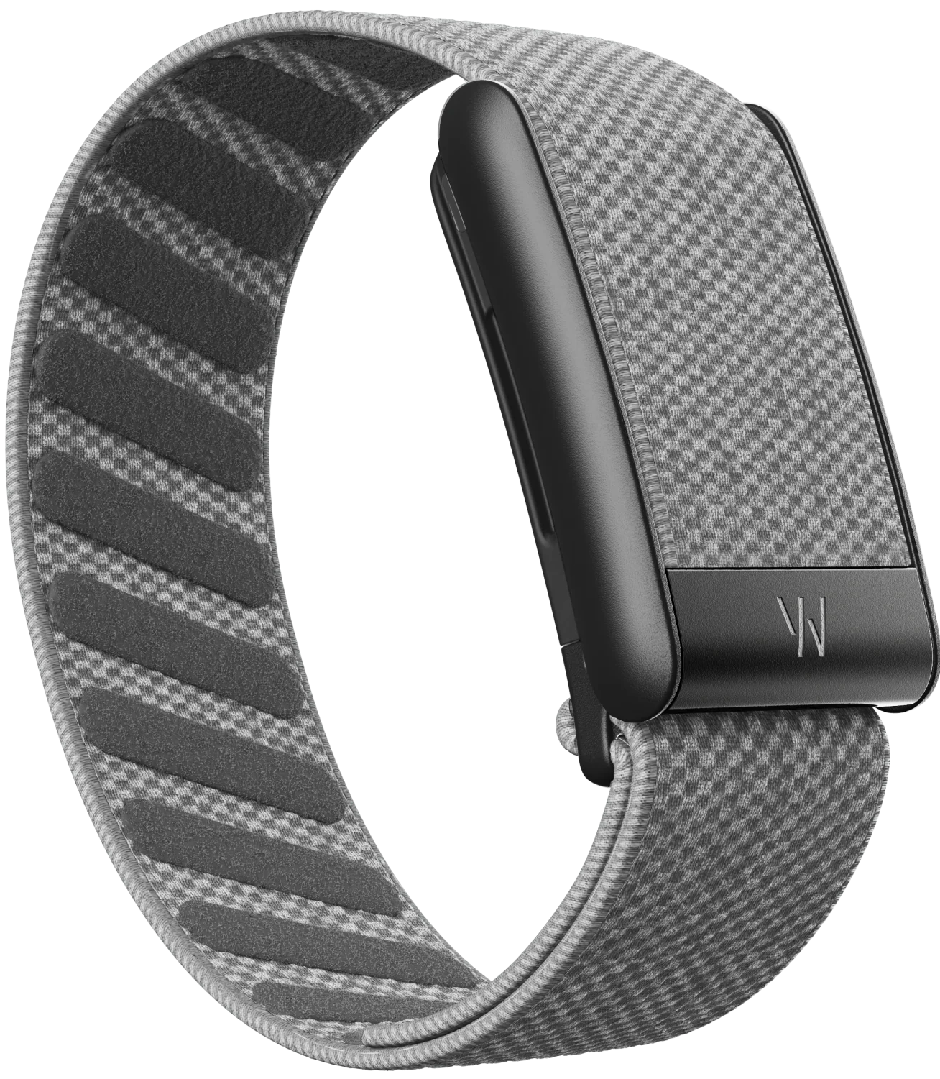
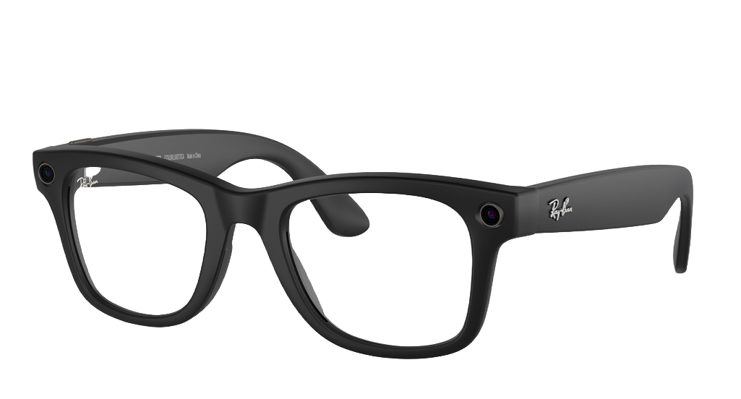
Marketplace for Human Activity Recognition
The marketplace for advanced HAR models is largely defined by the vertical integration of hardware manufacturers and AI developers, leading to the creation of powerful, proprietary FMs trained on massive, real-world data collected by their own devices.
Apple
Google Fitbit
Whoop
Meta
Utilizes data collected from their Apple Watch to train their own models
They offer fitness, sleep, heart health tracking
Utilizes data collected from devices such as Fitbit and Pixel Watch to train their own models
They offer fitness, sleep, heart health tracking
Powers their Whoop Band using GPT-4 and fine tunes the model
They offer fitness, sleep, heart health tracking
Utilizes data collected from devices such as their EMG wristband and AI glasses to train their own models
Their work is focused under AR & VR integration
Notes:
Maatla
What their devices offer
Size and capability of companies, whoop being a startup
Vertical integration for companies like apple, google and meta

Slide 10

Marketplace for Foundational Models
The marketplace for FMs in HAR and physiological signal analysis is highly consolidated, driven by entities that possess both vast device ecosystems for data collection and the massive computational resources required for pre-training models at scale
Apple
Google Deepmind
OpenAI
MetaAI
Notes:
Maatla

Slide 11
Significant Issues
Notes:
Maatla

Slide 12
The Triple Threat
Privacy
Consent
Data Ownership
Data Misuse
Security
Prompt Injection
Data Poisoning
Attack on Inference
Attack on Devices
Centralized Risk
Regulation
GDPR
HIPAA
NIST Risk Management Framework
Notes:
Maatla

Slide 13
Ongoing Work

Slide 14
Ongoing Work
Development into clinically validated diagnostic tools
Healthcare regulations
Expansion to more types of sensor data
Improvement of LLM ability to analyze and model wearable sensor data
Data quality
Computational requirements
Interpretability
Privacy concerns
Integration of AI powered recommendations and support into wearable devices
Device heterogeneity
Privacy concerns
Adaptive models that generalize across populations
Notes:
Sravya

Slide 15
Thank you

Slide 16
[1] E. Ferrara, "Large Language Models for Wearable Sensor-Based Human Activity Recognition, Health Monitoring, and Behavioral Modeling: A Survey of Early Trends, Datasets, and Challenges," Sensors, vol. 24, no. 15, p. 5045, Aug. 2024. doi: 10.3390/s24155045.
[2] S. B. Soumma, A. Mamun, and H. Ghasemzadeh, "AI-powered wearable sensors for health monitoring and clinical decision making," Current Opinion in Biomedical Engineering, vol. 36, p. 100628, 2025. doi: 10.1016/j.cobme.2025.100628.

